Slide 1
Texts and Strings
Mr Mack 2021

Slide 2
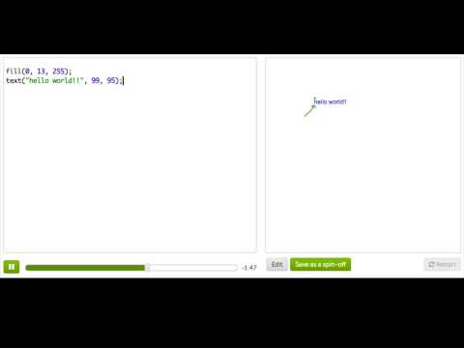
Terrific Text: Part One

Slide 3

Practice: My Favorite Foods
We're making a list of your favorite foods, but first we need a header. Write 'My Favorite Foods' near the top of the canvas.
Use the console to try to fix problems with the code, but sometimes he doesn't know what you're trying to do and how to fix it. If there is a problem with a text command, make sure that command has:
- Quotation marks around the entire message, like so: "My Favorite Foods";
- Commas in the right places, between every argument - check the hint code;
- Exactly 3 arguments: the message, the x position and the y position.
First, a heading!

Slide 4

Practice: My Favorite Foods
That text is small, aye? Let's make it easier to read by making the text bigger. You can change the size of your text by using the textSize command before the text command.
BIGGER text!

Slide 5
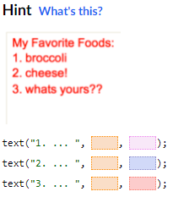
Practice: My Favorite Foods
Now, use the text() command three times, to make a list of your favorite foods. Each should be on a separate line.
If errors happen with a text command, make sure that command has:
- Quotation marks around the entire message, like so: "1. Brocolli" ;
- Commas in the right places, between every argument - check the hint code;
- Exactly 3 arguments: the message, the x position and the y position.
Now, the foods!

Slide 6
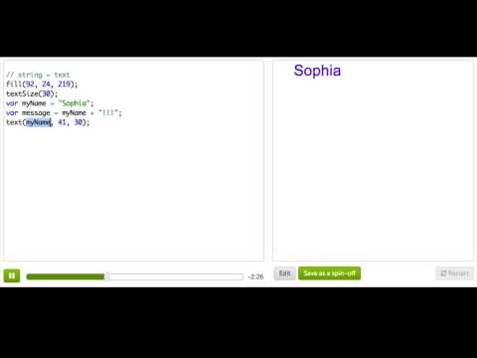
Terrific Text: Part Two

Slide 7

Practice: Mouse Tracker
To start our mouse tracking program, make it so that the ellipse() shows up at the user's mouse position, instead of always being in the same position.
Hint: Use the mouseX and mouseY variables to position your ellipse.
Follow the mouse with the pink ball!

Slide 8
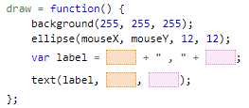
Practice: Mouse Tracker
To make this tracker more useful, you're going to constantly display a label with the current x and y mouse coordinates next to the dot. To do that:
- Add together mouseX, a string with a comma, and mouseY;
- Store that in a variable;
- Pass the variable into the text command and show it next to the ball.
Display the coordinates!

Slide 9
Review: text and strings
Here's a review of what we covered in this tutorial on text:
Before this tutorial, we were using number values for most things: passing numbers into functions, storing numbers in variables, etc. As you've now seen, we can also use text values. We call these text values strings in JavaScript; think of them as a string of letters.

Slide 10
Review: text and strings
To create a string, we surround text in quotation marks:
"Hello World!"
Then we have to actually do something with that string, like pass it to the text()text()t, e, x, t, left parenthesis, right parenthesis command:
text("Hello World!", 100, 100);

Slide 11
Review: text and strings
We could also store it in a variable, and then pass that variable into the text()text()t, e, x, t, left parenthesis, right parenthesis command:
var myGreeting = "Hello World!";
text(myGreeting, 100, 100);
Note that we can also use single quotation marks:
var myGreeting = 'Hello World!';

Slide 12
Review: text and strings
But we can't mix and match quotation marks—that's an error! Pick either single or double marks, and stick with them.
var myGreeting = 'Hello World!"; // oh noes!
Just like we can manipulate number values, we can also manipulate strings. We can, for example, add one string to another string:
var myGreeting = "Alo";
var myName = "Winston";
var sayHello = myGreeting + ", " + myName + "!"; // Alo, Winston!

Slide 13
Review: text and strings
When we combine strings in JS, we call it concatenating strings. We can also combine strings with number values:
var xPos = 10;
var yPos = 20;
var label = "The coordinates are " + xPos + ", " + yPos;
We also saw in this tutorial that we can use different commands to change the text size and text color when we display strings using the text()text()t, e, x, t, left parenthesis, right parenthesis command.

Slide 14
Challenge: Ad design
Change the big headline to the name of your product.
Add at least 2 more text function calls advertising the product.
Change the text size so that you display text in at least 3 sizes.
Add a relevant drawing with at least 3 shape or image function calls.
Bonus: Play around with color and positioning to make it more flashy. If you want to go really wild, add an animation!
In the text challenges, you showed that you know how to use text commands. Now, use that knowledge to make an advertisement for a real or made-up product!

